Slide 1




PYTHON in dynamo
PRAGATHEESH KUMAR

Slide 2

Python in dynamo
Basic Examples

Slide 3
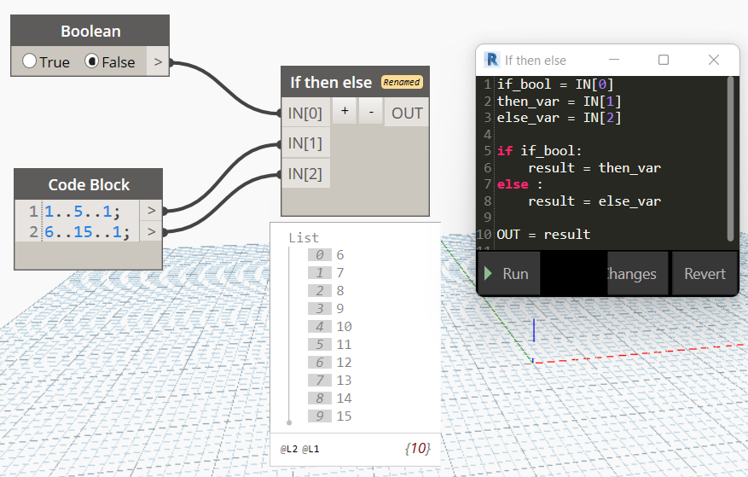
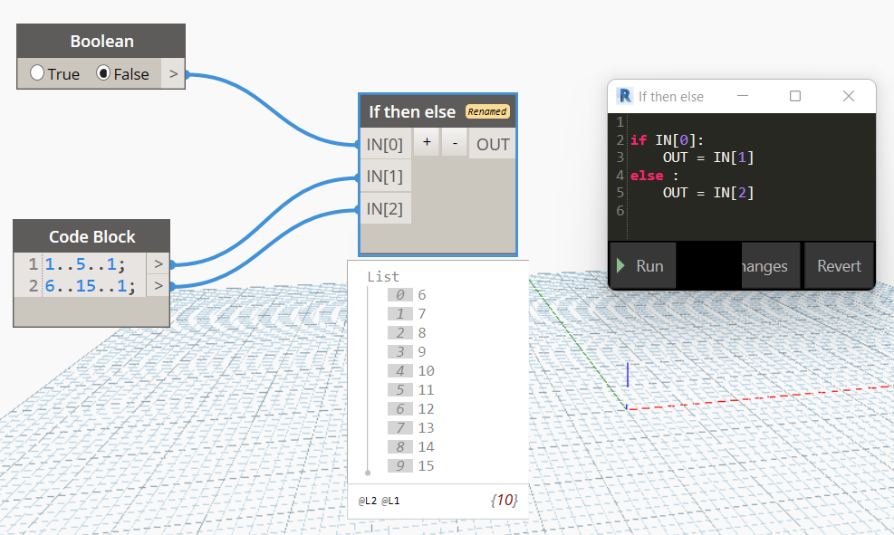
Python in Dynamo Basic Example – If then else

Slide 4
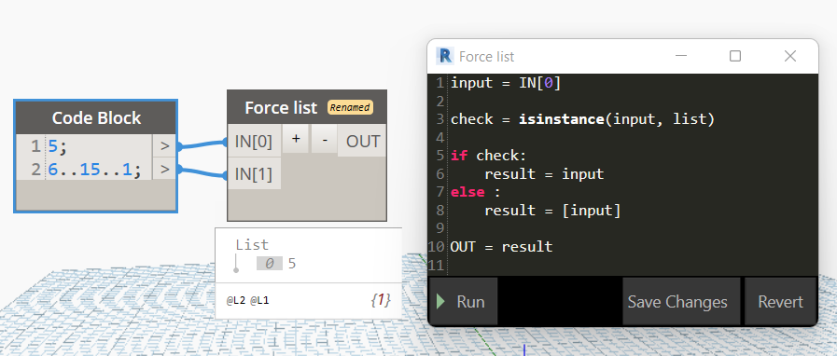
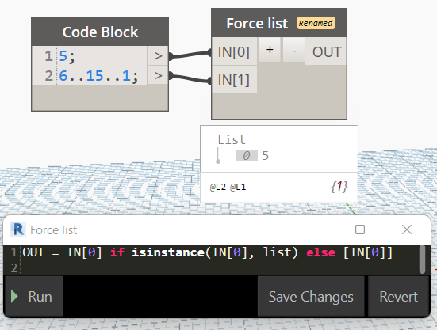
Force list: It’s a important technique in Python for Dynamo

Slide 5
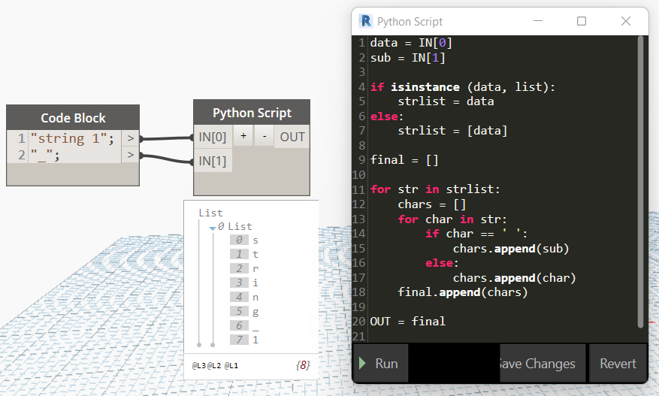
Explode String: Basic iteration

Slide 6
Next on #

Slide 7


Thank You
Pragatheesh kumar
Pragatheesh.kumar6@gmail.com

